Slide 1
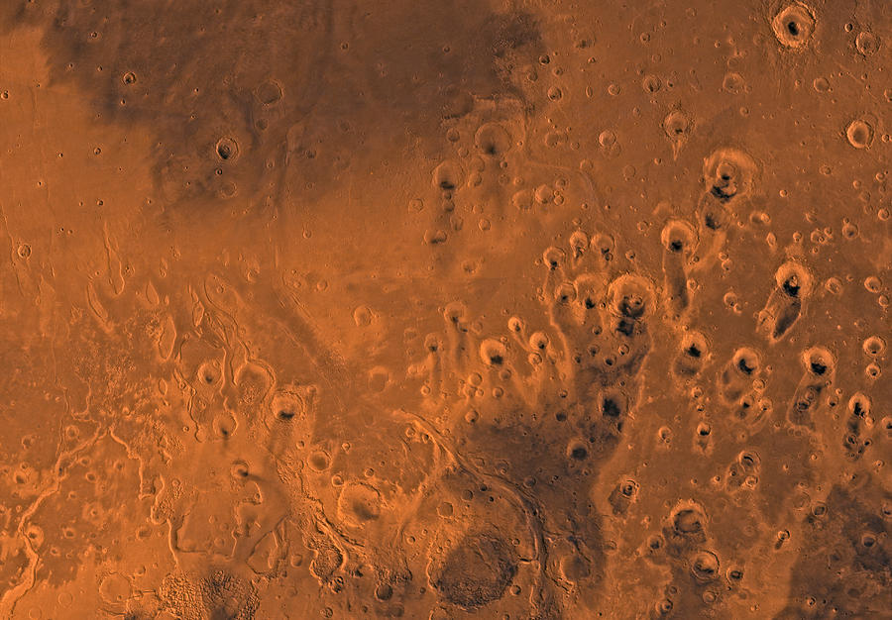



Dune Exploration on Mars
Student: Danielle Clarke and Mentor: Briony Horgan
ASU/NASA Space Grant Program

Slide 2
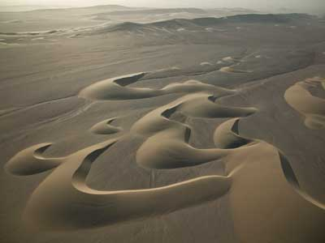
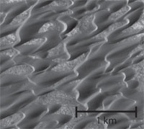
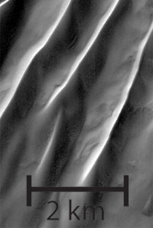
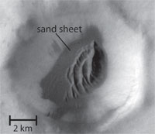
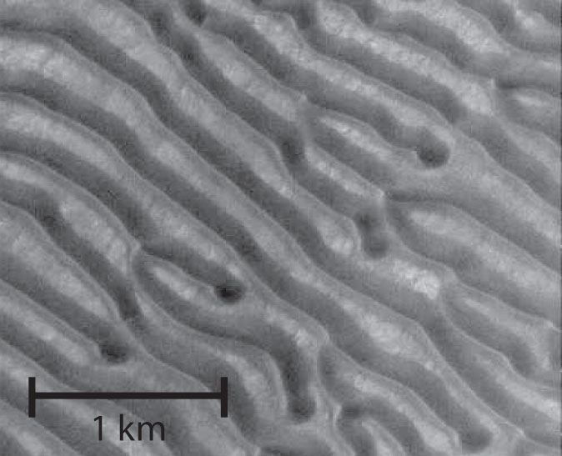

What are Sand Dunes?
Dunes are created through erosion of rocks and weathering, dunes shift and move in different directions
Dunes on Earth are created by the erosion of by rocks by rivers and oceans
Rivers and oceans are a rare find on Mars, so how is sand created on Mars?
Figure 1: Crescentic Sand Dune in Nambia, Africa
Figure 2: Different types of Dunes on Mars(McKee,1979)

Slide 3
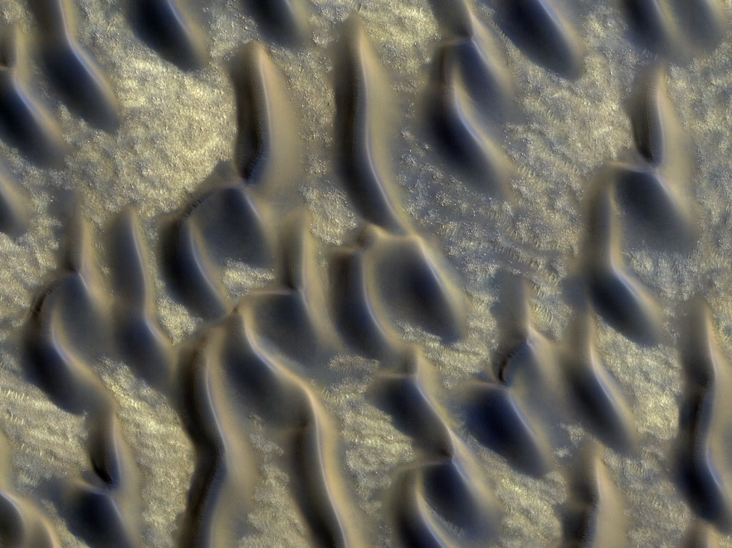
What are sand dunes made of on Mars?
The glass might be volcanic ash which once came from volcanic eruptions
Dunes on Mars contain volcanic minerals like olivine, pyroxene like Earth
Glass was recently discovered in the north polar sand sea on Mars
Hypothesis we are testing: Some Martian sand dunes are made of volcanic ash

Slide 4
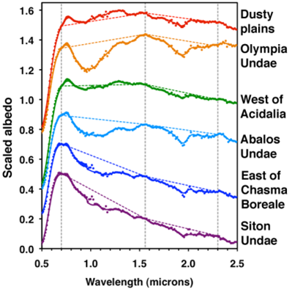
How do we identify glass on Mars?
Near Infrared Spectra on Mars
The glass has a unique spectral signature in the near infrared that suggests that is has been weathered by water
Peaks shift to the left with weathering
Shape gets more concave with weathering
Dust
Basaltic Dunes
Unweathered Glass
More Weathered
Glass
Very Weathered Glass
Weathered glass has a peak at shorter wavelengths and the shape of the spectrum turns out to be more concave up
We calculated the median of the albedo, peak position and concavity for 50 dune fields to locate glass
Figure 3: Near Infrared Spectra on Mars

Slide 5
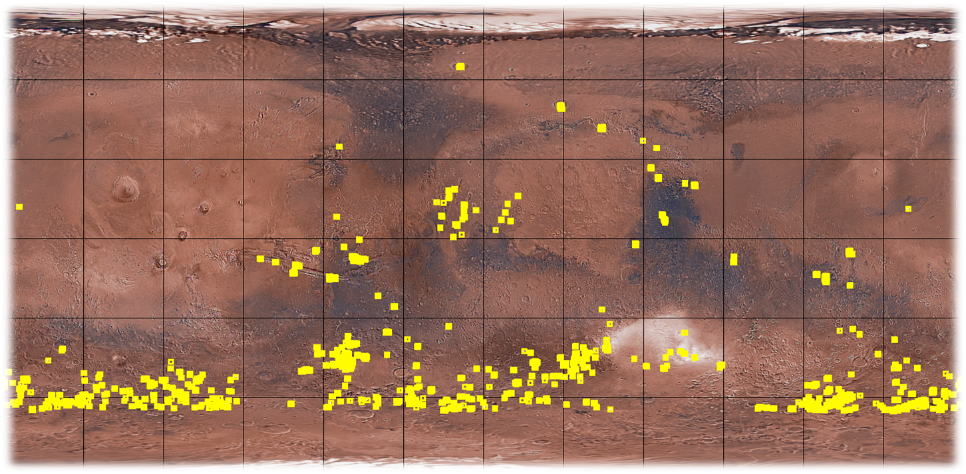
Where are the Dunes on Mars Located?
Figure 4:Map of Mars, Dunes are in yellow
( Mars Global Digital Dune Database).

Slide 6
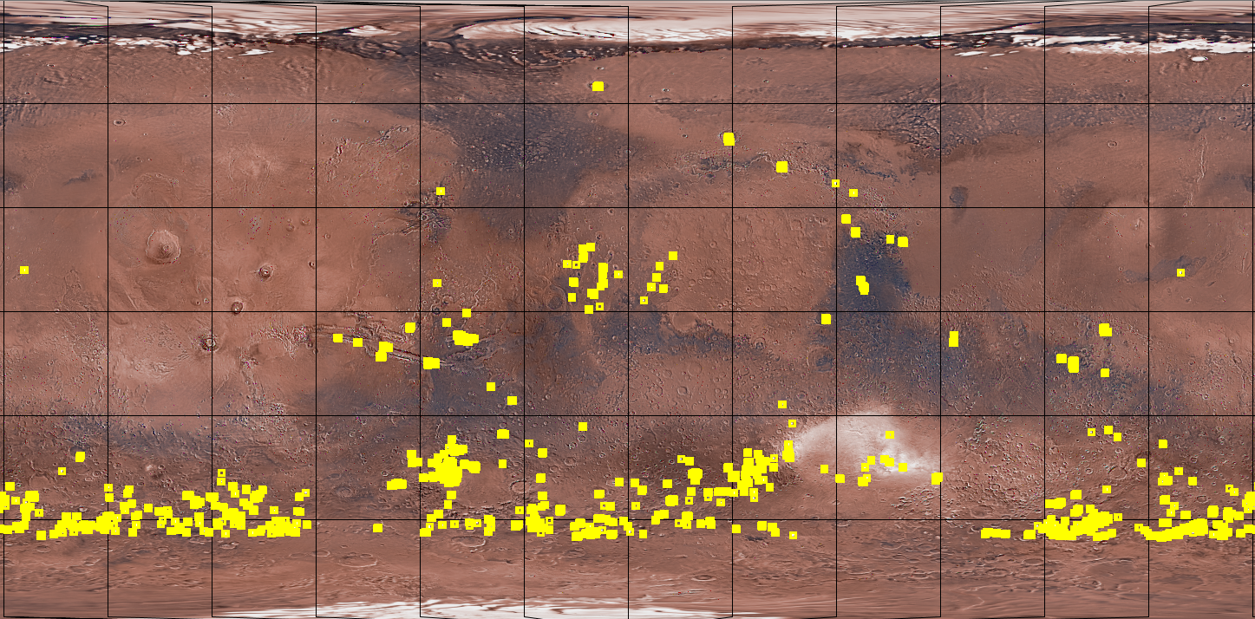
Dunes we have examined so far:
Figure 5:Map of Mars, Dunes are in yellow
( Mars Global Digital Dune Database).

Slide 7
What does our data say about the glass in the dune fields on Mars?
More glass
Figure 6: Albedo Vs. Concavity Graph
Albedo:
Is a measure of the brightness of the dunes, and glass should have a low albedo
Glass is dark, so the trend in this plot is what we predicted

Slide 8
What does our data say about the glass in the dune fields on Mars?
More Glass
Figure 7: Peak Position Vs. Concavity of All Dunes
A low Peak Position and a high Concavity is a signature of weathered glass .

Slide 9
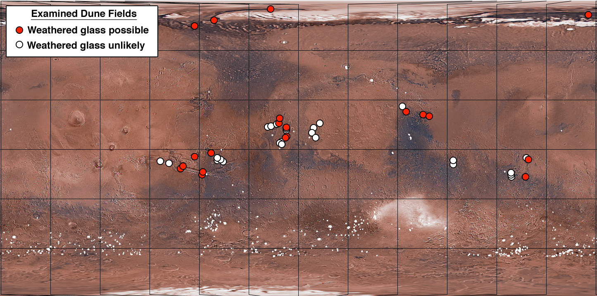
Result: Glass may be common in martian sand dunes
Figure 8: Distribution of examined dune fields (Horgan, Clarke, Bell 2012)

Slide 10
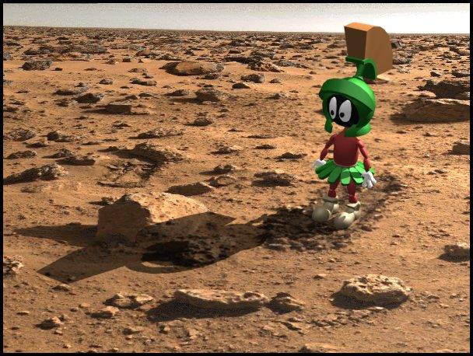
Thank you

Slide 11
What does our data say about the glass in the dune fields on Mars?
More Glass
Figure 9: Albed0 Vs. Peak Position of All Dunes
A low Peak Position is a signature of weathered glass, Glass has a low albedo. This positive relationship was predicted.

Slide 12
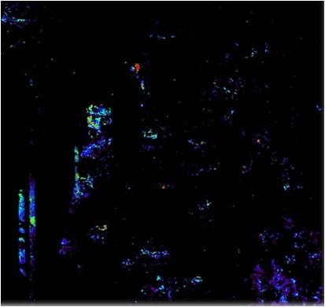
Visual Data
Figure 9: Peak position in Oxia Palus. Blue indicates a low position, red indicates a high position. Dust is red, while the dune fields are in the green and blue areas
Figure 10: Concavity in Oxia Palus. The colored areas have more concave spectra.

Slide 13
Mars Global Digital Dunes Database
Latitudinal Region | Number of Dune Fields | % of Total Number of Dune Fields | Area of Dune Fields (km²) | % of Total Area
30° to 65° N | 9 | 1.6 | 1507 | 2.2
0° to 30° N | 36 | 6.6 | 5165 | 7.4
0° to 30° S | 37 | 6.8 | 13,275 | 19.0
30° to 65° S | 465 | 85.0 | 49,803 | 71.4
Total | 547 | 100 | 69,750 | 100
Figure 10: Amount of dune fields on Mars from North to South (www.mar-dunes.org)

